Slide 1
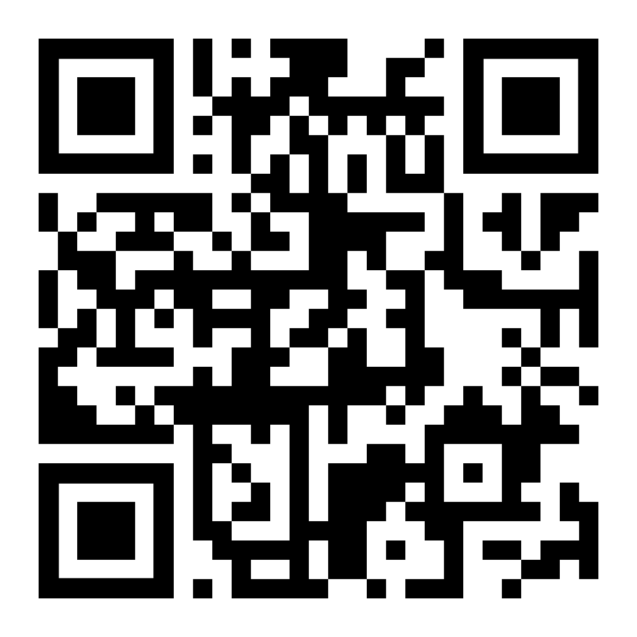
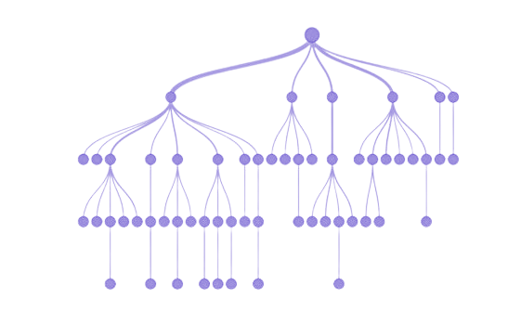
Theory Lecture #1: Decision Trees & Random Forests
Attendance Form
October 24th, 2022

Slide 2

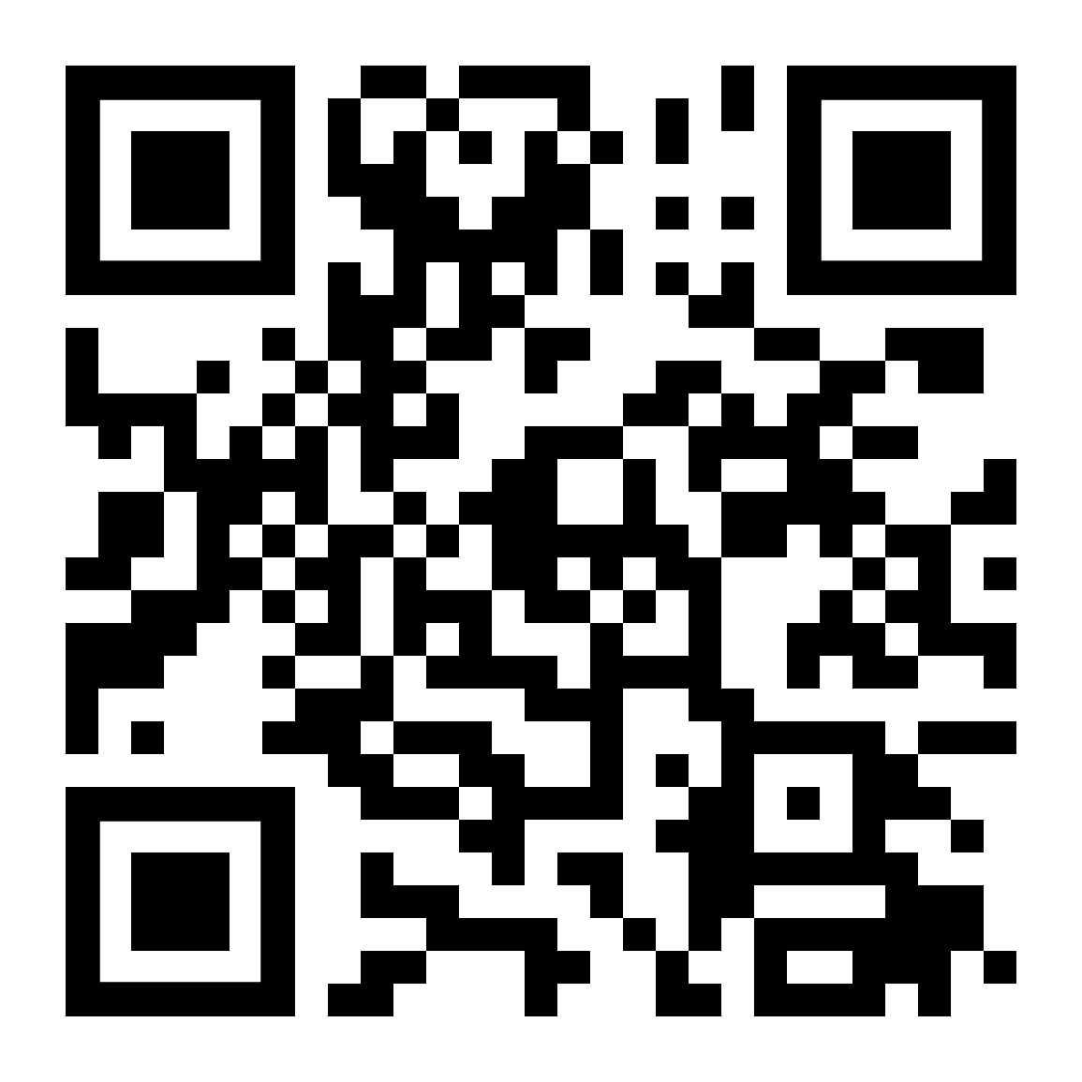
Recap & Announcements
ML: data → features → train model → make predictions
Supervised (labels), unsupervised, reinforcement
Room change & Discord
Discord QR Code

Slide 3
What are Decision Trees?
Series of true/false questions to narrow down a prediction
IRL examples:
  20 Questions
  Purchasing a car
  Investing into a company
  Quitting your job
Supervised learning method
Can be used for classification and regression

Slide 4
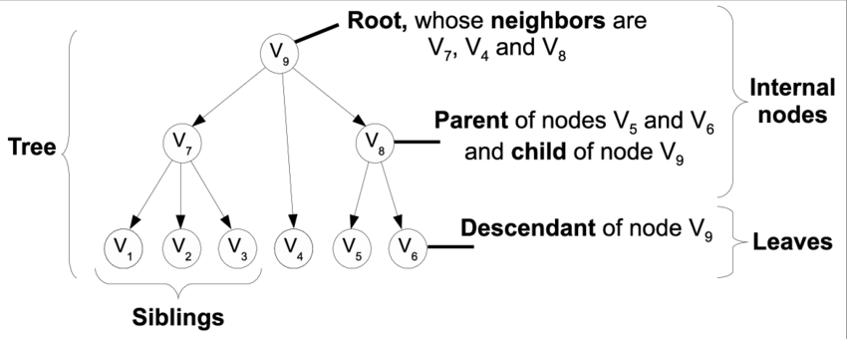
Tree Terminology

Slide 5
The Idea
Goal: Can I ski?
90°
0°
Latitude
-90°
1
12
Time (months)

Slide 6
The Idea
Goal: Can I ski?
lat > 30
yes
no
90°
time < 4
lat < -10
yes
no
yes
no
time > 8
time < 4
0°
Latitude
yes
no
yes
no
time > 8
yes
no
-90°
1
12
Time (months)

Slide 7
What are Decision Trees, Really?
Greedy, top-down, recursive model which splits based on a threshold for a particular feature
Easy to understand, interpretable
  Pneumonia paper
How do we determine the split?

Slide 8
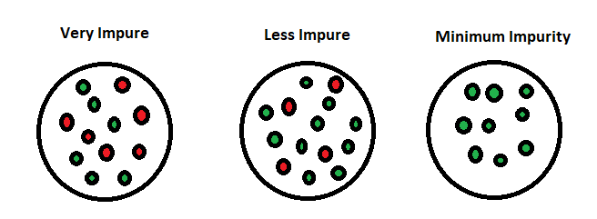
Splitting
Want as many pure nodes as possible
Entropy: impurity in a group
Information gain: how much information a feature provides about a class
  Also reduction in entropy for a random variable
Maximize information gain
IG = Eparent − (Echild 1 + Echild 2)

Slide 9
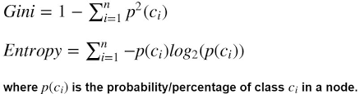
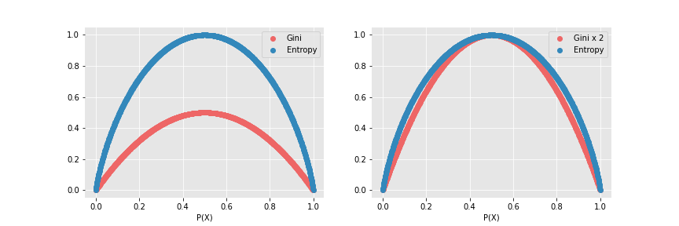
Impurity Measures
Loss functions → minimization
Cross-entropy loss
Gini loss
Brute force to determine which feature and threshold to use

Slide 10
Overfitting
Will happen if we split too much
The model is “too close to the data”
Can no longer generalize and make good predictions
Causes high variance: changes much more with small changes in input

Slide 11
Regularization for DTs
Minimum leaf size
Max depth
Max number of nodes

Slide 12
Some Variants
We’ve been talking about classification trees
Regression trees
  Average the values in a leaf node to predict
Categorical variables

Slide 13
Overview - Pros/Cons
Pros:
Interpretable
Categorical variables
Low bias
Cons:
Low predictive accuracy
High variance

Slide 14
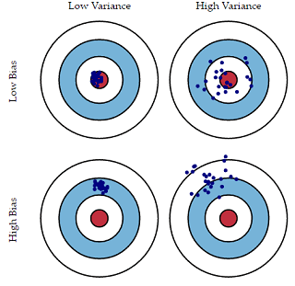
Bias-Variance Tradeoff
Bias: Fitting to training data poorly (underfitting)
Variance: Not able to generalize well (overfitting)
Increase one → decrease the other
DTs are low bias, high variance

Slide 15
Ensembling
Combining DTs to improve predictive performance.

Slide 16
Ways to Ensemble
Different algorithms
Different training sets
Bagging (Random Forests)
Boosting (Adaboost, xgboost)

Slide 17
Bagging (Bootstrap Aggregation)
Decreases variance
Bootstrap samples = random training sets
Train a unique model for each sample
Average the predictions from the models

Slide 18
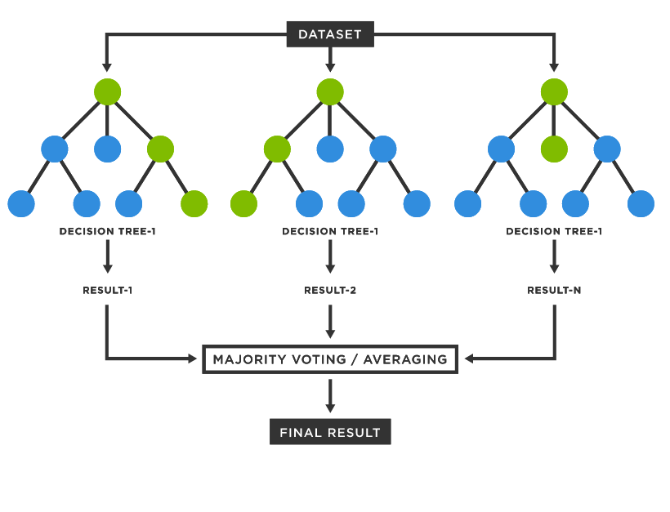
Random Forests
Variant of bagging for DTs
For each DT, only consider a fraction of the features randomly
Average predictions from each DT
High predictive accuracy, slow to predict & hard to trace

Slide 19
Random Forests - Algorithm
Define # of trees
  Max depth, information gain (Gini vs. entropy)
Bootstrapping
  Randomly choose rows from full dataset and subset of features
Train individual DTs
Aggregating

Slide 20
Boosting
Decrease bias
Train one model, add prediction to ensemble, repeat
Adaboost
  Train on size 1 DTs (stumps)
  Adjust weight of mistakes, repeat
Also xgboost, gradient boosting

Slide 21
Applications
Decision Trees:
BP’s GasOIL System (1986)
Learning to fly a plane on a flight sim (1992)
Ensembling methods:
Kaggle
Stock prediction, breast cancer diagnosis, product recommendations, and much more!

Slide 22
Recap
DTs = trees of true/false predictions to identify classes
Interpretable, bad for predictions
Can be used for classification, regression, and use categorical variables
Ensembling improves predictive performance
Random Forests = averaging a bunch of DTs
Next week: workshop session and group projects!

